Slide 1

Mendelian Genetics
biological data science
spring 2019

Slide 2
Locus
Locus: a fixed position within the genome
May be large region or just a single nucleotide
Locus (location)

Slide 3
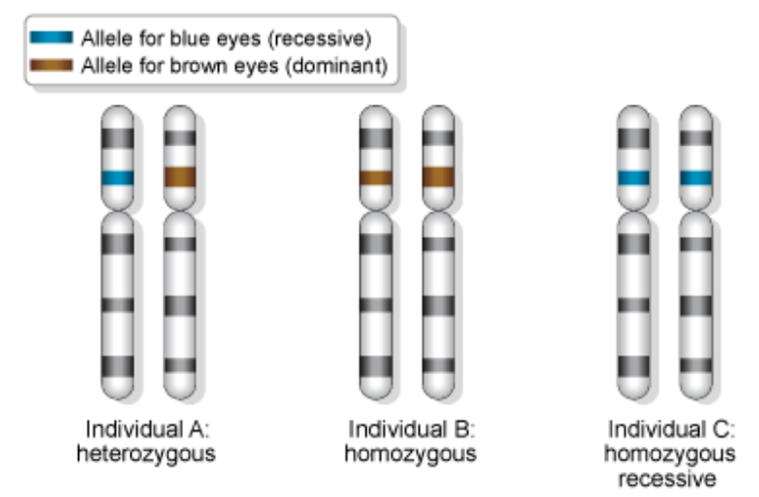
Allele
One of two or more genetic alternatives
Found at the same place (locus) on the chromosome
Allele (alternative)

Slide 4
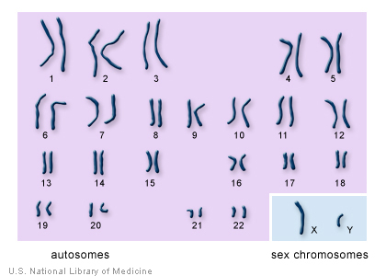
Genotype
Both alleles carried by an individual
Variable size:
May be entire genome, some genomic region, or a single nucleotide locus
Genotype (genetic marker)

Slide 5
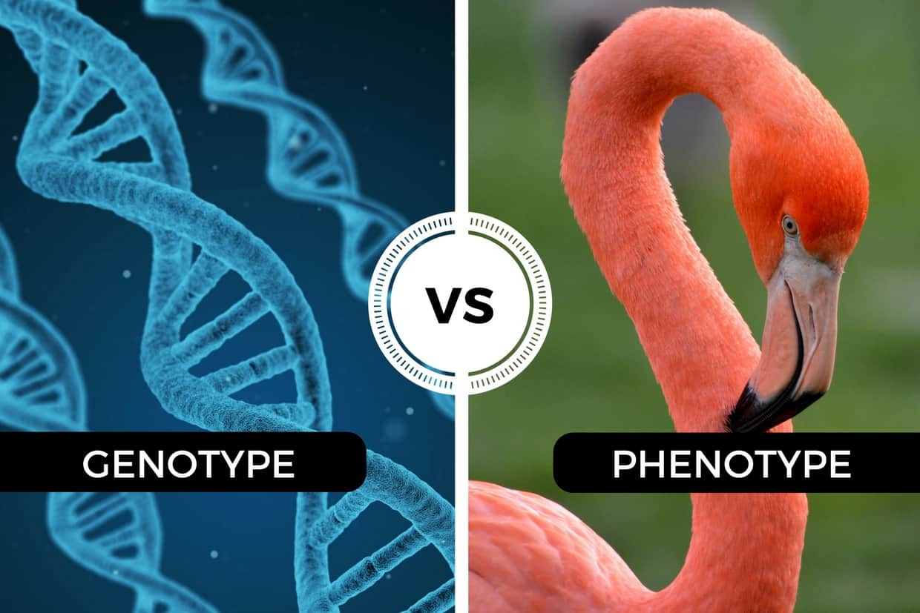
Phenotype
Observable trait(s)
May be eye color, disease state, blood pressure, drought tolerance, etc.
Phenotype (physical trait)

Slide 6

Gregor Mendel
What phenotypes did he study?

Slide 7
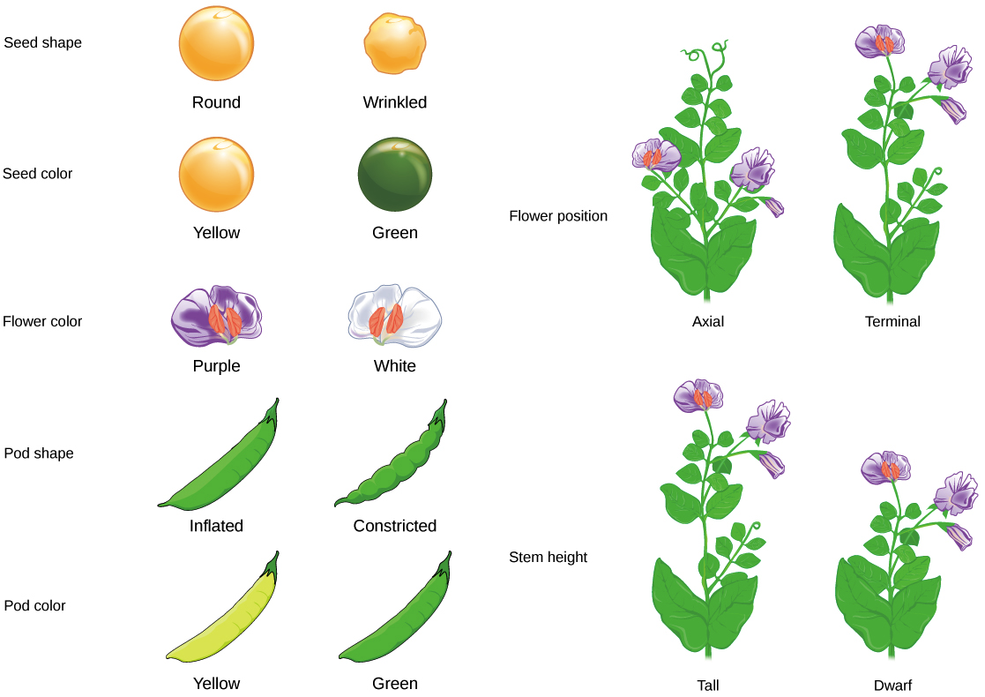

Slide 8
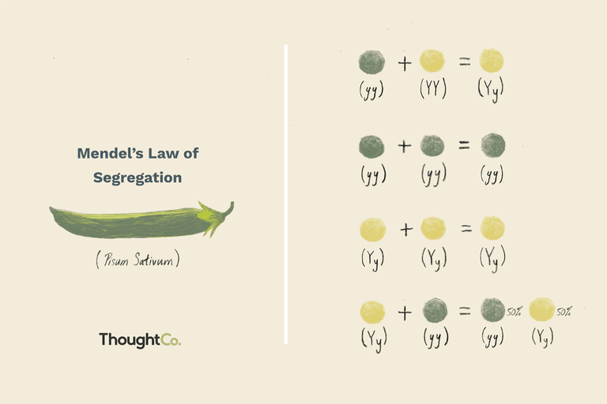

Slide 9
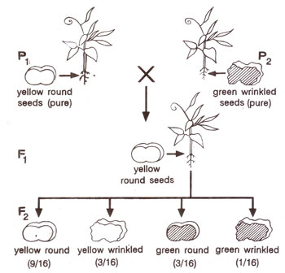
Law of Independent Assortment
States that alleles for separate traits are passed independently of one another
This is not always true!

Slide 10
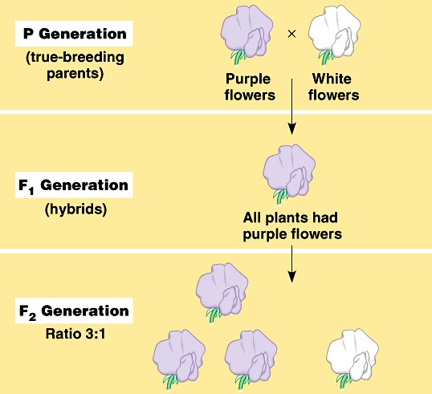
Law of Dominance
For heterozygous genotypes, one allele may be dominant over the other allele
This is not always true!

Slide 11
Hemochromatosis
Mike carries two copies of the ‘A’ nucleotide at marker rs1800562 on chromosome 6
85% of individuals with hemochromatosis carry two copies of the ‘A’ nucleotide
Hemochromatosis is an iron storage disorder
Iron isn’t effectively removed from body
Symptoms:
Cirrhosis of the liver, diabetes, heart failure
Treatment:
Consume less iron
Drawing blood
What is the locus of interest here?
What is the allele?
What is Mike’s genotype?
What is the phenotype?
Does the genotype alone account for the risk of exhibiting
the phenotype?

Slide 12

Genetic testing
23andme tests for hemochromatosis

